Slide 1
Image Convolution
Parallel Computation Patterns - Convolution
Week 4
Minia - CUDA Teaching Center March – 2015

Slide 2
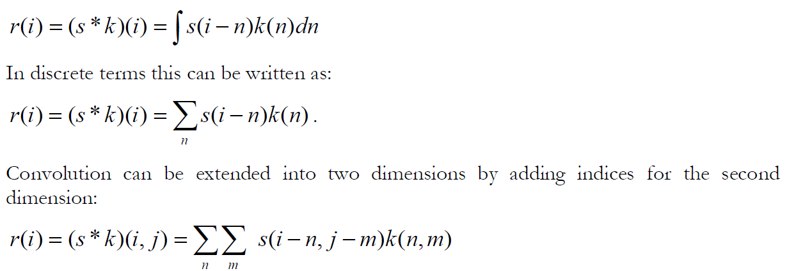
What is Convolution ?
Mathematically, a convolution measures the amount of overlap between two functions [1]. It can be thought of as a blending operation that integrates the point-wise multiplication of one dataset with another

Slide 3
Reference: Coursera Parallel Heterogeneous Systems (Online Course)

Slide 4
Reference: Coursera Parallel Heterogeneous Systems (Online Course)

Slide 5
Example: Image Blur
Original Image
Blur convolution filter

Slide 6
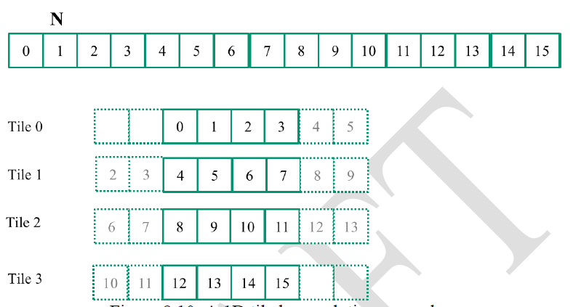
Example 1D Convolution

Slide 7
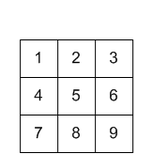
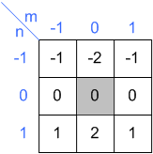
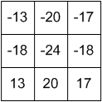
Full Example 2D Conv. Example:
Input
Kernel (Convolution MAKS)
Output

Slide 8
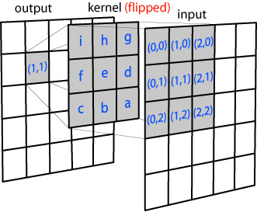
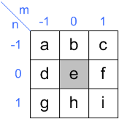
How it is done? [2]
Stencil operation

Slide 9
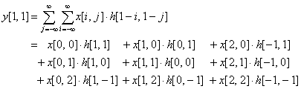
How it is done? [2]

Slide 10
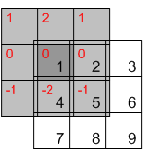

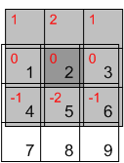

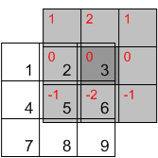


Slide 11
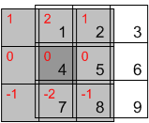

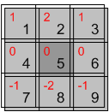

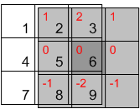


Slide 12
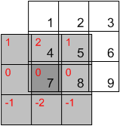

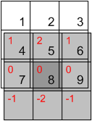

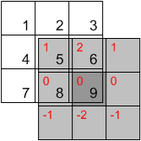


Slide 13
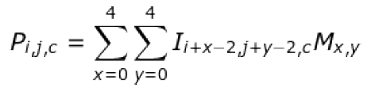
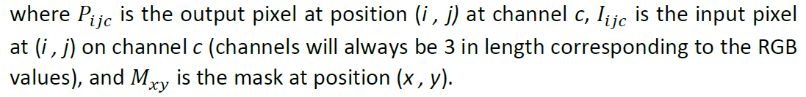
2D Image Convolution

Slide 14
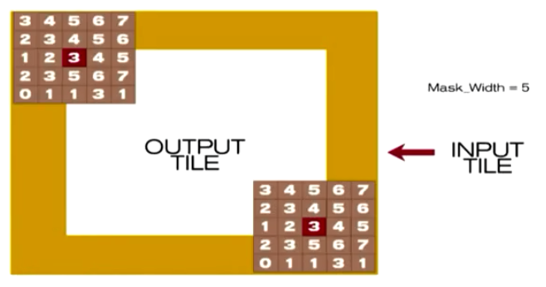
Grid, Block dims.
dim3 dimGrid((imageWidth + TILE_WIDTH - 1)/TILE_WIDTH,
(imageHeight + TILE_WIDTH - 1)/TILE_WIDTH,
1);
dim3 dimBlock(TILE_WIDTH, TILE_WIDTH, imageChannels);

Slide 15
References
[1] Wolfram Mathworld. “Convolution” http://mathworld.wolfram.com/Convolution.html
[2] Convolution http://www.songho.ca/dsp/convolution/convolution.html#convolution_2d
[3] https://www.evl.uic.edu/sjames/cs525/final.html

